Slide 1

SIEM
Splunk

Slide 2
Overview of SIEM
SIEM stands for security information and event management and provides organization with next-generation detection, analytics and response.
SIEM software combines security information management (SIM) and security event management (SEM) to provide real time analysis of security alerts generated by applications and network hardware.
Data aggregation, correlation, alerting, and reporting.
Improved security visibility, faster incident response.

Slide 3
Overview of SIEM
It Provides:
Real-time visibility across an organization's information security systems.
Event log management that consolidates data from numerous sources.
Correlation of events gathers from different logs or security sources
Automatic security event notifications.

Slide 4
SIEM
Log Collection
Normalization
Correlation Engine
Log Storage
Device
Monitoring

Slide 5
SIEM
Its major job or its function is to perform data aggregation, correlation among different data and alerts as well and then it also pop up any new security events or alerts and build the reports as well.
Its a beneficial because it helps us with the security visibility.
We can get a 360 view of what all happening in the network and this also helps us with the better incidence response.

Slide 6
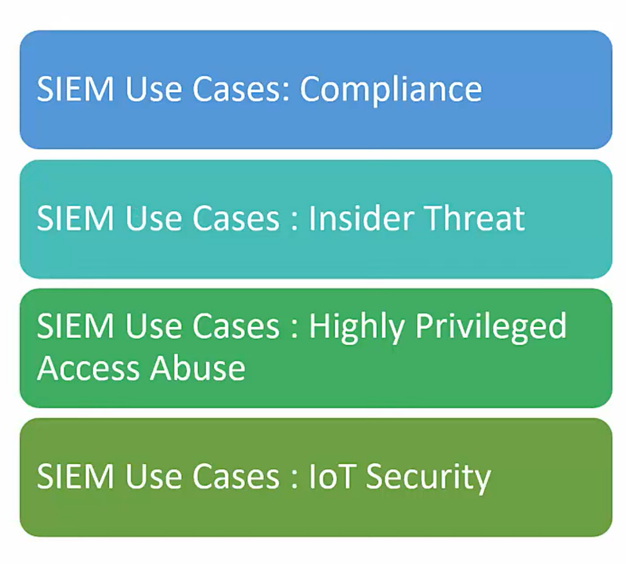
SIEM Use Case

Slide 7
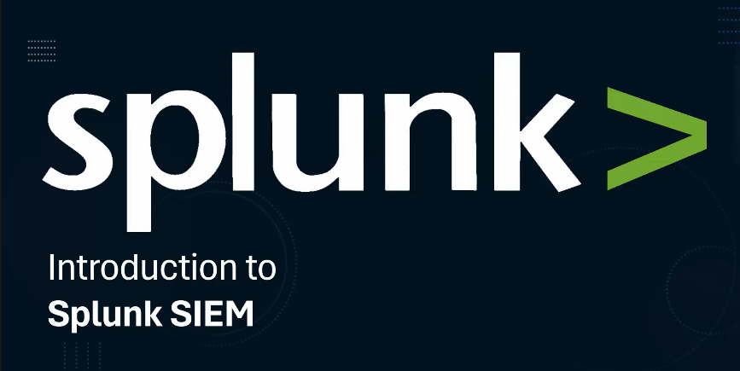
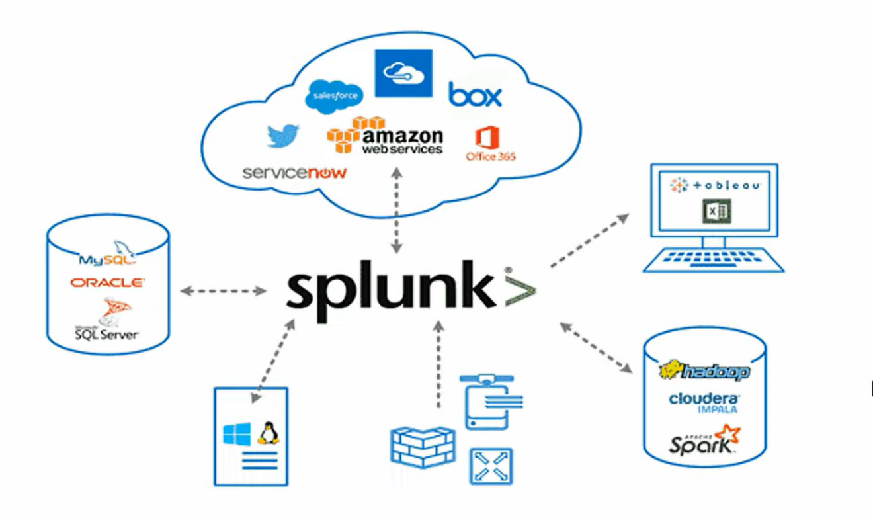
Introduction to Splunk
Splunk is a software platform to search, analyze and visualize the machine-generated data gathered from the websites, applications, sensors, devices etc.

Slide 8
Introduction to Splunk
A leader in data analytics and SIEM
Collect, indexes, and analyzes machine generated data.
Searching
Analyzing
Visualizing
Data
Correlation
Indexing
Monitoring

Slide 9
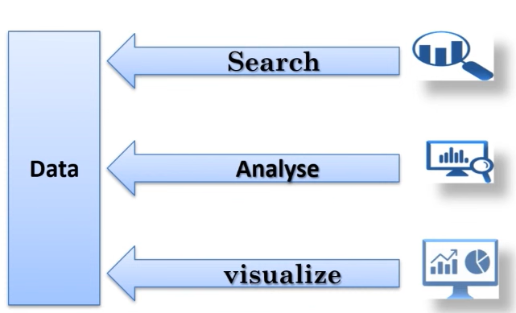
Overview of SIEM

Slide 10
Splunk for SOC Analyst
Splunk was founded in 2003. it's a very-very powerful solution in data analytics.
It's not just a SIEM solution but its also very powerful in data analytics activity as well.
Currently Splunk is a leader in SIEM market.
What you see it's basically Gartner quadrant and then this you can see Splunk as mentioned in the leader section.
Because it's specialized in analyzing machine related data. It's widely used in the IT operations, security and business analytics as well.

Slide 11
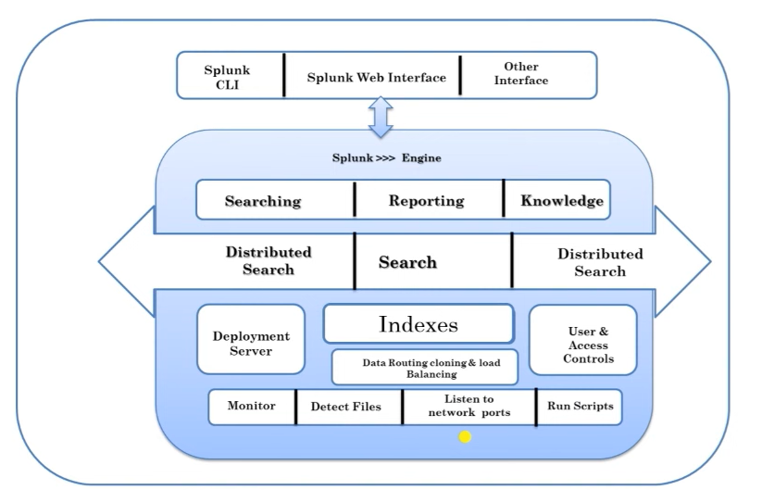
Splunk Architecture

Slide 12
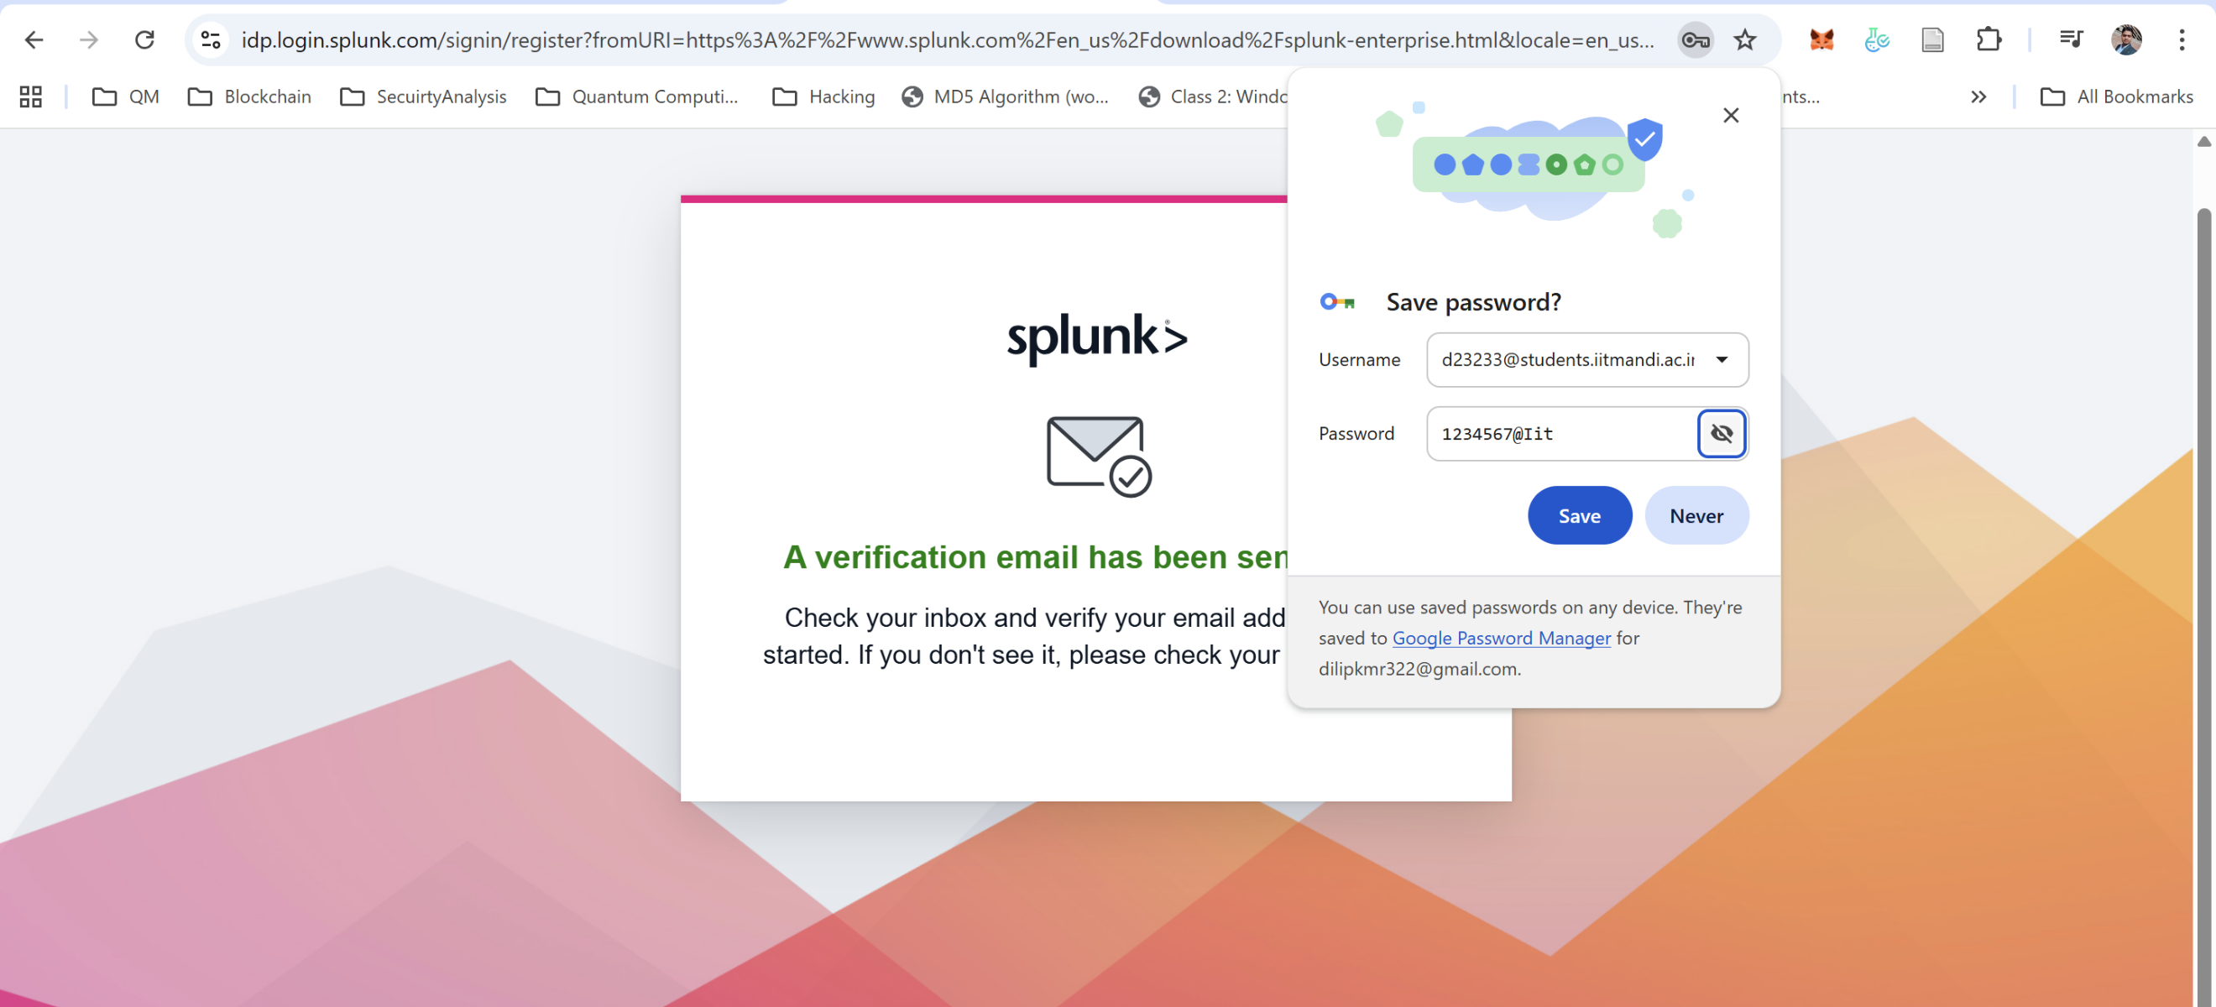
Splunk

Slide 13
Splunk
It’s very powerful in terms of collecting, indexing, analyzing machine generated data.
Indexing is like giving an addressing or you know locating every events that happening in the network. Just like google index every page on the internet of every website.
Similarly, in Splunk, the job of a SIEM solution is to index every events properly and help the admin to analyze them.
Splunk collect the data from different sources from OS, to databases, to different cloud infrastructure, router, switches, firewall as well and then help to get a complete 360 view.

Slide 14
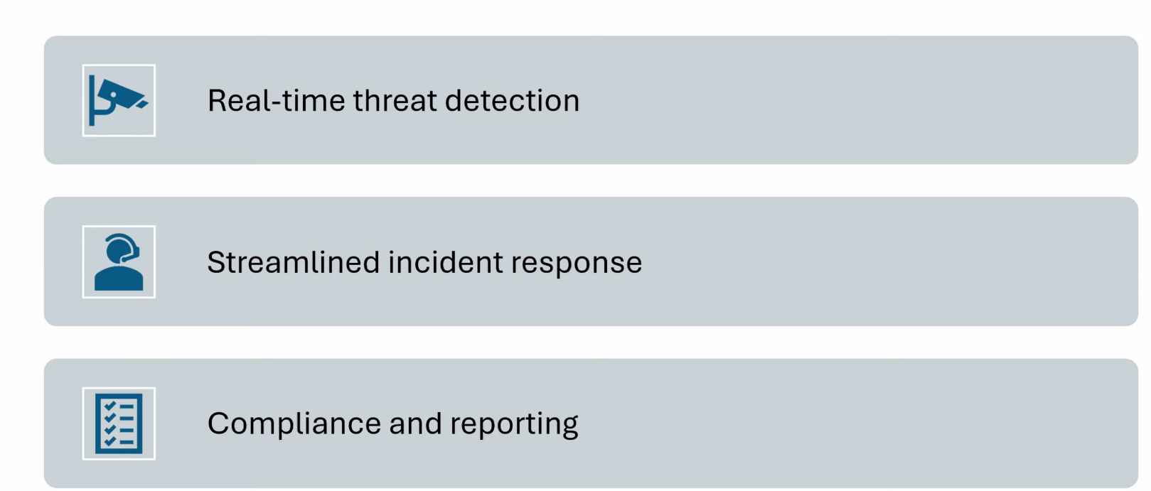
Importance of Splunk in Security Operations

Slide 15
Importance of Splunk in Security Operations
It help us to get a better real time threat detection.
In cyber security in security operations, the quicker is better.
Next streamline the incident response
With Splunk basically there is a different apps comes in which is called Enterprise security. You have to buy that additional app from Splunk. Once you get that it will help you to streamline your incident response very well, where you can check any alerts, you can work on different advanced threats. you can create different correlation rules. for example, you can create a rules that if any brute force attack attempt happen in this period of a time, I should get an alert and that can be treated as a very serious alert.
Then we have a compliance and reporting option, with this we can manage different compliances from PCDS ISO compliances, different regional compliances like Hippa compliance, gdpr compliance as well.

Slide 16
Start, Stop and Restart Splunk
$ cd /opt/splunk/bin
$ sudo ./splunk status # Checking status of Splunk whether its started/not
$ sudo ./splunk start # Starting service of Splunk
$ sudo ./splunk stop # Stopping service of Splunk
$ sudo ./splunk restart # Restarting service of Splunk

Slide 17
Splunk
Start Service
sudo /opt/splunk/bin/splunk start
How to make it start automatically
If we don't want to type that command every time you boot your Kali VM, you can enable boot-start. This tells the system to launch Splunk as soon as the OS loads.
Run this command once while Splunk is running:
sudo /opt/splunk/bin/splunk enable boot-start

Slide 18
Splunk
A. Monitor your Kali Logs (The "Defense" View)
We can tell Splunk to index your own system logs so you can see whenever someone tries to sudo or log in.
In the Splunk Web UI, click Add Data.
Select Monitor -> Files & Directories.
Browse to /var/log/auth.log (this tracks login attempts and sudo commands).
Follow the prompts to save it. Now, try running a few sudo commands in your terminal and search for them in the "Search & Reporting" app.

Slide 19
Splunk
B. Brute Force Analysis
If you are practicing with tools like Hydra or Burp Suite, you can point those attacks at a local target and use Splunk to visualize the massive spike in "Failed Login" attempts. It’s a great way to see what a real-time attack looks like from a SOC (Security Operations Center) analyst's perspective.
C. Install the "Splunk Security Essentials" App
Inside the Splunk UI, you can browse for "Apps." Search for Splunk Security Essentials. It’s free and provides guided walkthroughs on how to detect common threats like:
Data Exfiltration
Lateral Movement
Malware infections

Slide 20
Splunk
3. Essential Commands to Remember
Since you are running this in a VM, you might want to manage the service from the terminal occasionally:
Check if it's still running: sudo /opt/splunk/bin/splunk status
Stop the service before shutting down your VM: sudo /opt/splunk/bin/splunk stop
Restart if you change configurations: sudo /opt/splunk/bin/splunk restart

Slide 21
Splunk
.\VBoxManage modifymedium "C:\Users\dilip\VirtualBox VMs\New group\Kali\Kali.vdi" --resize 30720
sudo /opt/splunk/bin/splunk start --accept-license
sudo /opt/splunk/bin/splunk status
Switch to root:
sudo -i
Run the command again:
/opt/splunk/bin/splunk start --accept-license
The Fix: /opt/splunk/bin/splunk start --accept-license --run-as-root

Slide 22
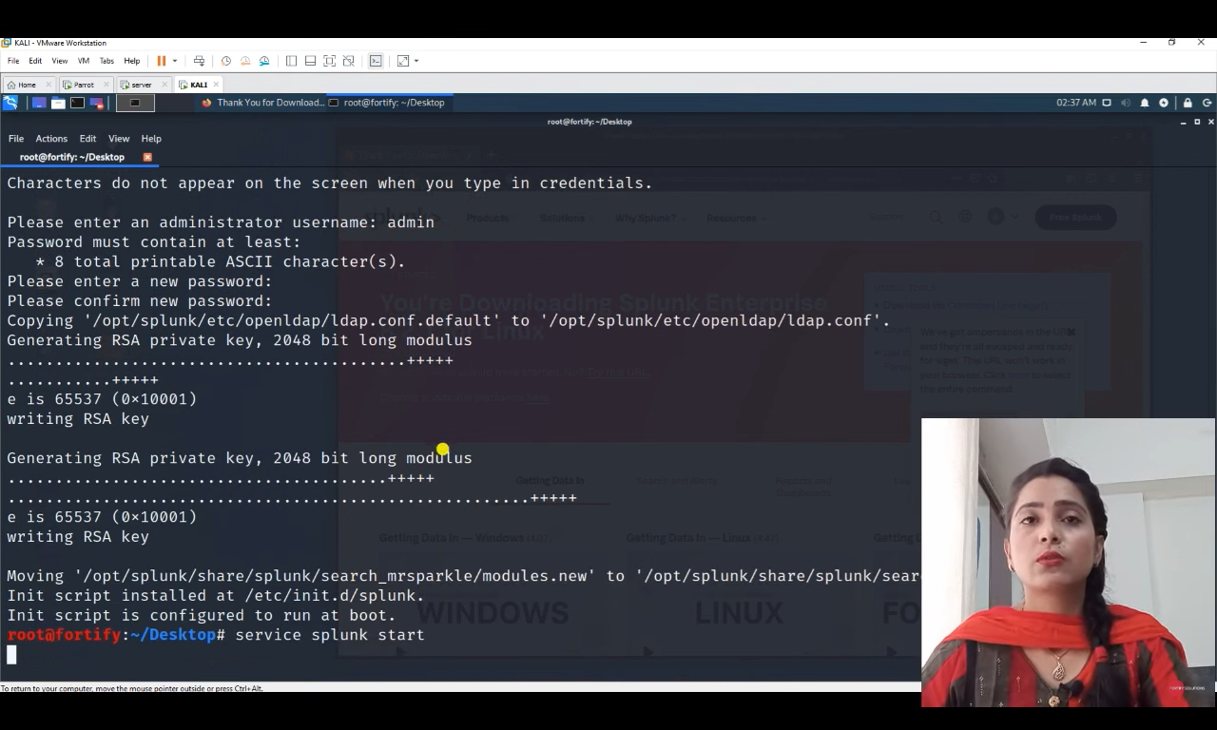
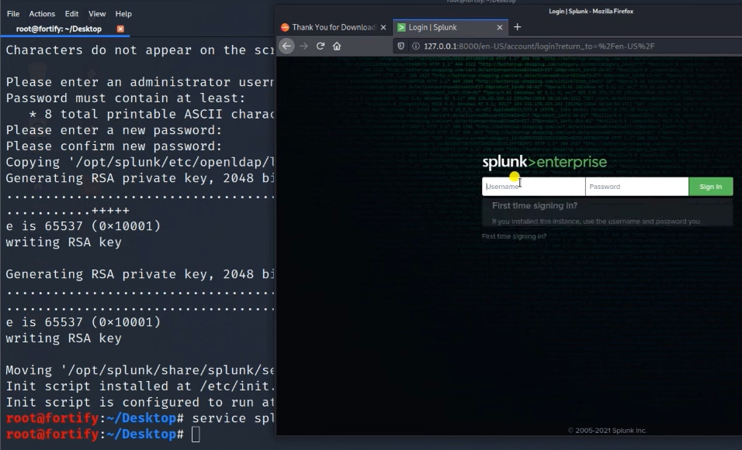
Splunk

Slide 23
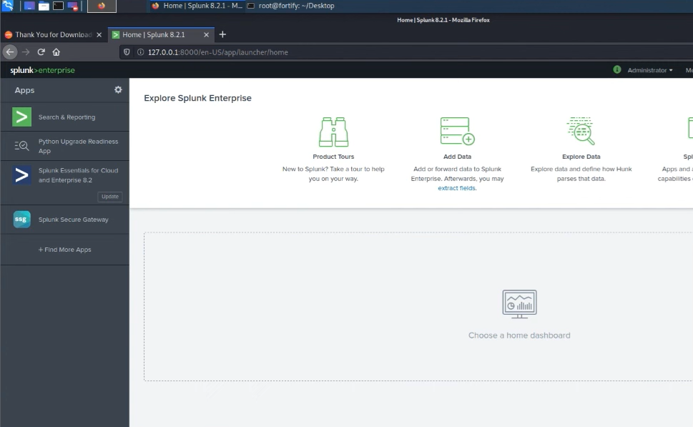
Splunk

Slide 24
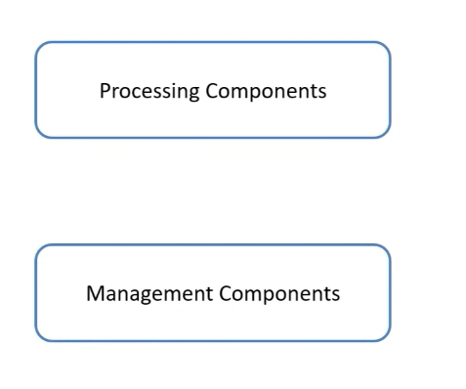
Splunk Components

Slide 25
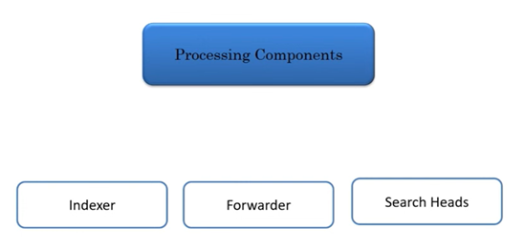
Splunk Components

Slide 26
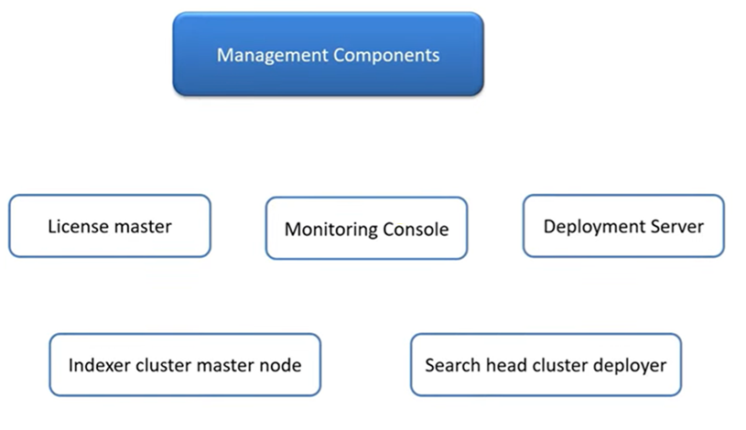
Splunk Components

Slide 27
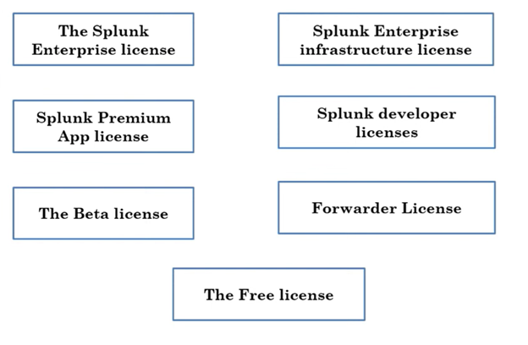
Types of Splunk

Slide 28
Thankyou

